Slide 1

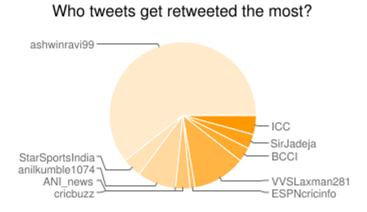
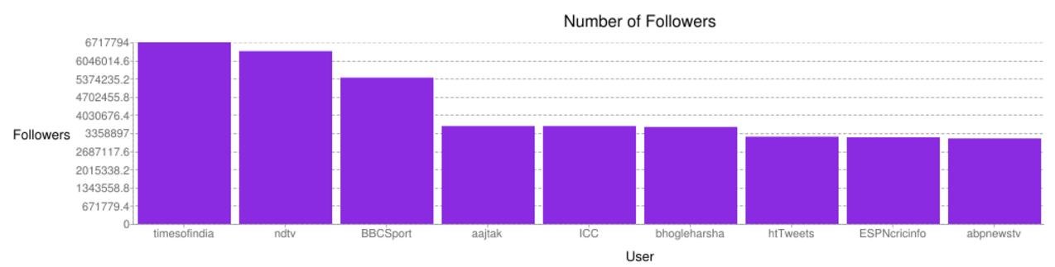
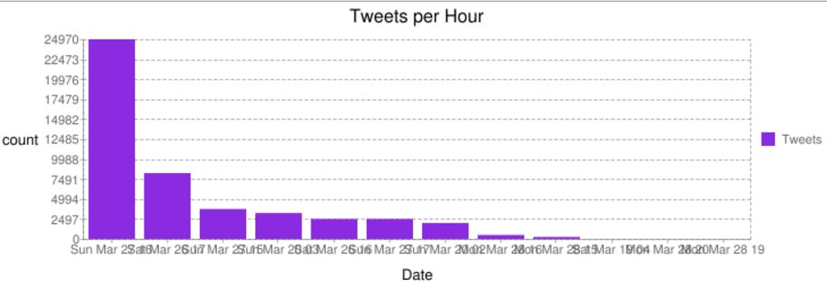
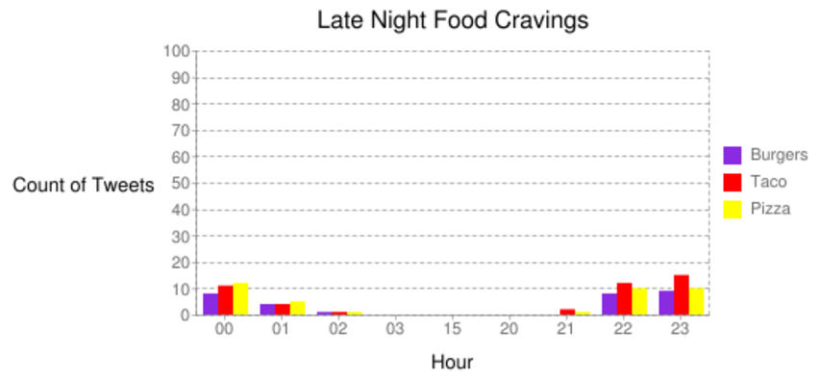
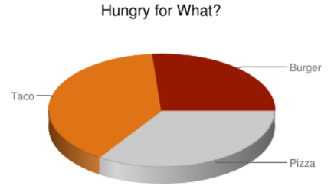
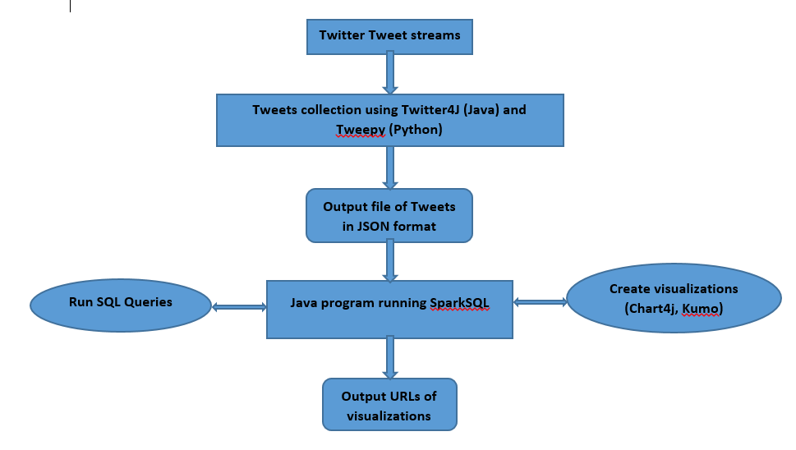
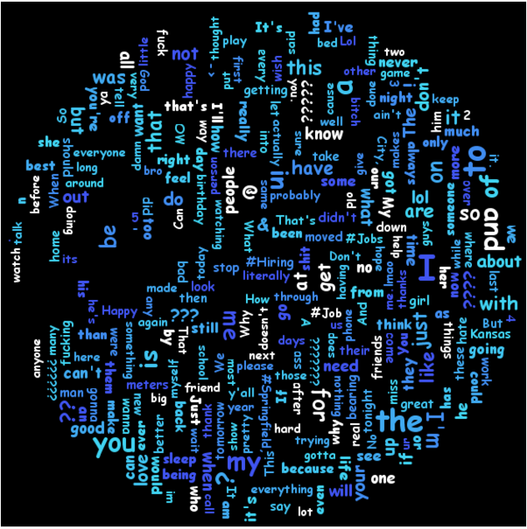
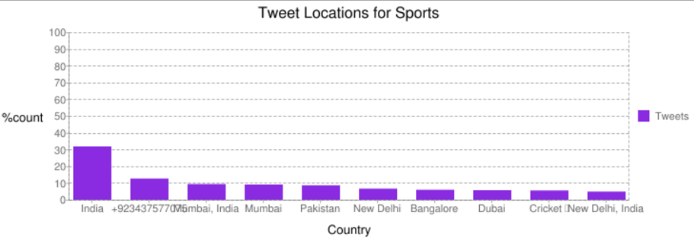










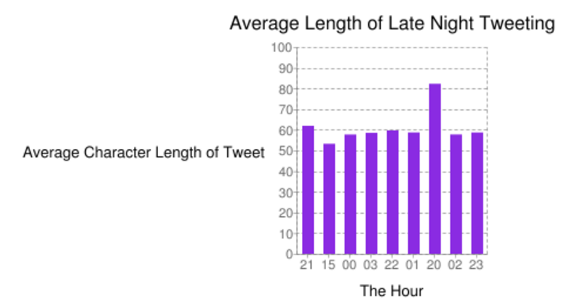
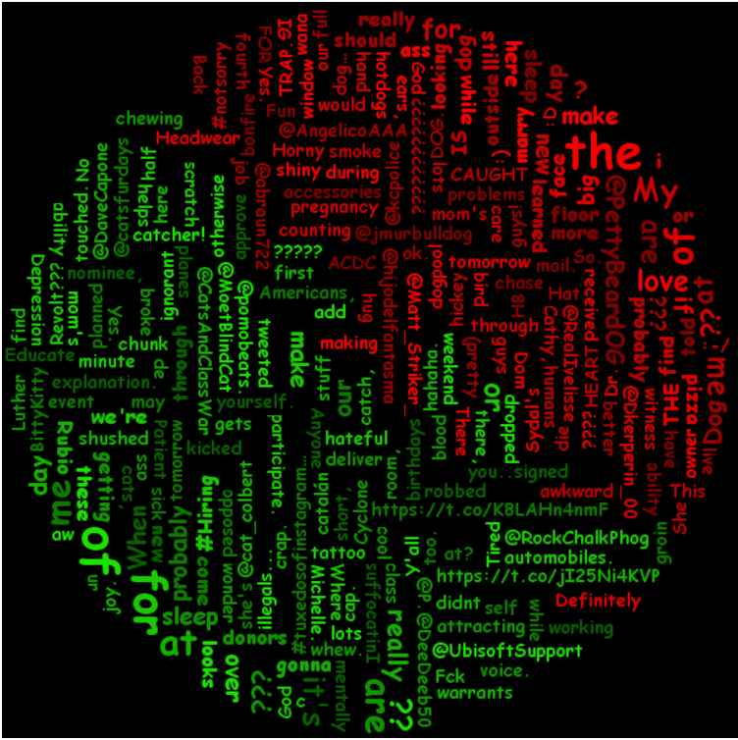
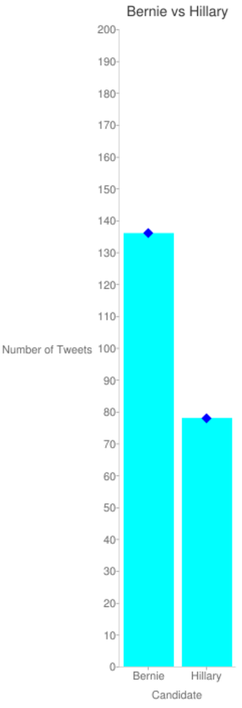
Twitter Tweets Analysis using Apache Spark
Justin Baraboo(jjbkb4), David Rodgers (daryt7), Santhosh Kumar Gattu (sg6n6)
Introduction
Query 5
Late night food cravings for people in the Kansas City Area, primarily from 8PM to 3 AM
DataFrame taco = sqlContext.sql("SELECT createdAt FROM GoodTweets WHERE UPPER(text) LIKE UPPER('%taco%')"+
" OR UPPER(text) LIKE UPPER('%mexican%food') OR UPPER(text) LIKE + “UPPER('%Chipotle%')");
DataFrame burger = sqlContext.sql("SELECT createdAt FROM GoodTweets WHERE UPPER(text) LIKE UPPER('%burger%')"
+ " OR UPPER(text) LIKE UPPER('%McDonalds%') OR UPPER(text) LIKE UPPER('%Wend%')");
DataFrame pizza = sqlContext.sql("SELECT createdAt FROM GoodTweets WHERE UPPER(text) LIKE UPPER('%pizza%')"+
" OR UPPER(text) LIKE UPPER('%Papa John%') OR UPPER(text) LIKE UPPER('%Domino%')");
JavaPairRDD<String,Integer> hours = sqlContext.sql("SELECT SUBSTRING(createdAt, 12,2) as hour FROM GoodNightTweets").distinct().toJavaRDD().mapToPair(row -> new Tuple2<String,Integer>(row.getString(0),0));
List<Tuple2<String,Integer>> pizzaList = pizza.toJavaRDD().mapToPair(row -> new Tuple2<String,Integer>(row.getString(0),1)).union(hours).reduceByKey((int1,int2) -> int1 + int2).collect();
Data is enormously increasing from the past few years, storing and processing this humongous amount of data is the biggest problem the world is facing.
One of the main source for generating data is Twitter which produces around 8 Tera Bytes amount of data per day.
Data analytics using Apache Spark helps in analyzing the twitter data and to gain useful insights for making future decisions.
Query 2:
Number of tweets generated per hour
DataFrame tweetsperhour = sqlContext.sql(" SELECT a.date, count(text) as cnt FROM"+
" ( SELECT text, SUBSTRING(created_at,0,13) AS date"+
" FROM Tweets where text!= '')a"+
" GROUP BY a.date ORDER BY cnt desc");
Query 8
Words most tweeted
DataFrame wordsMostTweeted = sqlContext.sql("SELECT text FROM GoodNightTweets");
EXPLANATION:
This looks at all tweets and then with this:
ArrayList<Tuple2<String, Integer>> words = new ArrayList<Tuple2<String,Integer>>( wordsMostTweeted.javaRDD().flatMap(
row -> Arrays.asList(row.get(0).toString().split(" "))).mapToPair( word -> new Tuple2<String, Integer>( word, 1)).reduceByKey((count1, count2) -> count1 + count2).collect());
Collections.sort(words, new Comparator<Tuple2<String, Integer>>() {
@Override
public int compare(Tuple2<String, Integer> o1, Tuple2<String, Integer> o2) {
// TODO Auto-generated method stub
return o1._2() > o2._2() ? -1 : o1._2() < o2._2() ? 1 : 0;
}
});
Aims & Objectives
The main AIM of the project was to collect Twitter Tweets, store and perform analytics on top of it using Apache Spark to gain useful insights.
Tweets were collected on trending topics like #WT20, #SuperTuesday and regarding Kansas city.
Collected tweets were stored in JSON format and using Eclipse and SparkSQL context interesting analytical queries were written.
Visualizations were created for the queries using Chart4j and Kumo user interface libraries.
Architecture
Query 3:
Distribution of tweets across locations and the user language respectively
DataFrame loclang = sqlContext.sql("SELECT user.location, user.lang, COUNT(text)cnt FROM SportTweets WHERE user.location IS NOT NULL GROUP BY user.location, user.lang ORDER BY cnt desc limit 10“);
Query 6
Length of tweets (in the text field) as a function of the hour of the day
DataFrame lenTweet = sqlContext.sql("SELECT text, createdAt FROM GoodTweets");
lenTweet.show();
Extra Java code to format output:
JavaPairRDD<String,Integer> thing = lenTweet.javaRDD().mapToPair(row -> new Tuple2<String, Integer>( row.getString(1).substring(11, 13), row.getString(0).length()));
for(Tuple2<String,Integer> tuple : thing.reduceByKey( (num1, num2) -> num1 + num2 ).collect() ){
System.out.println(tuple._1() + "," + tuple._2());
}
Map<String, Object> count = thing.countByKey();
ArrayList<String> hours = new ArrayList<String>();
ArrayList<Double> averageTL = new ArrayList<Double>();
for(Tuple2<String,Integer> tuple : thing.reduceByKey( (num1, num2) -> num1 + num2 ).collect() ){System.out.println(tuple._1() + "," + tuple._2()/((Long) count.get(tuple._1())).doubleValue() );
hours.add(tuple._1());
averageTL.add(tuple._2()/((Long) count.get(tuple._1())).doubleValue());
}
Query 9
Frequent words in two different set of Tweets
DataFrame catTweeted = sqlContext.sql("SELECT text FROM GoodNightTweets WHERE UPPER(text) LIKE UPPER('%cat%')");
DataFrame dogTweeted = sqlContext.sql("SELECT text FROM GoodNightTweets WHERE UPPER(text) LIKE UPPER('%dog%')");
ArrayList<Tuple2<String, Integer>> words1 = new ArrayList<Tuple2<String,Integer>>( catTweeted.javaRDD().flatMap(row -> Arrays.asList(row.get(0).toString().split(" "))).mapToPair( word -> new Tuple2<String, Integer>( word, 1)).reduceByKey((count1, count2) -> count1 + count2).collect());
ArrayList<Tuple2<String, Integer>> words2 = new ArrayList<Tuple2<String,Integer>>( dogTweeted.javaRDD().flatMap(row -> Arrays.asList(row.get(0).toString().split(" ")) ).mapToPair(word -> new Tuple2<String, Integer>( word, 1)).reduceByKey((count1, count2) -> count1 + count2).collect());
Tools
Query Results
Query 4
Which Democratic candidate (Bernie Sanders or Hillary Clinton) is tweeted about more
DataFrame bern = sqlContext.sql("SELECT * FROM GoodTweets WHERE UPPER(text) LIKE UPPER('%bern%')");
DataFrame hillary = sqlContext.sql("SELECT * FROM GoodTweets WHERE UPPER(text) LIKE UPPER('%hillary%')");
Query 1
Most famous person with the help of retweets and tweet count
DataFrame famous = sqlContext.sql("SELECT a.name, a.location, count(a.text) AS total_tweets, sum(a.retweets) AS total_retweets "+
"FROM (SELECT " +
" retweeted_status.user.screen_name as name,"+
" retweeted_status.user.location as location,"+
" retweeted_status.text as text,"+
" max(retweeted_status.retweet_count) as retweets"+
" FROM Tweets"+
" GROUP BY retweeted_status.user.screen_name,retweeted_status.user.location,retweeted_status.text)a"+
" GROUP BY a.name, a.location"+
" ORDER BY total_retweets DESC LIMIT 10 ");
Query 7
Number of Followers for top 10 users
DataFrame followers = sqlContext.sql("SELECT user.screen_name, max(user.followers_count) FROM tweets WHERE user.screen_name is NOT NULL GROUP BY user.screen_name ORDER BY max(user.followers_count) DESC limit 10")

